Slide 1
CS608 Algorithms
Week 7 Dr. Tom Schmidt

Slide 2
Week 7 Agenda
Le Quiz
Balanced and B-Trees
Red-Black Trees
Dynamic Programming?
Make a Midterm
Wrap-up and review

Slide 3
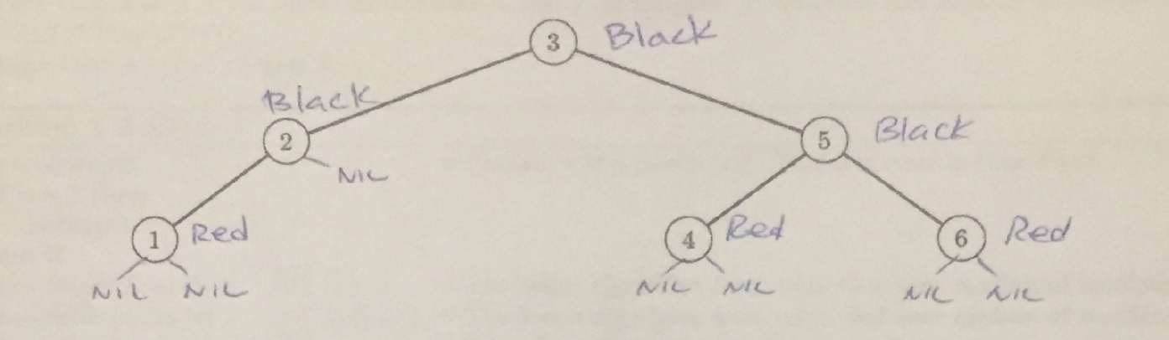
Le Quiz
1) Several students mentioned that Quicksort was more efficient as it could work better with Cache Memory in a processor. Explain what they mean
2) Why is the Hashtable the ultimate data structure?
3) Find another valid coloring of the following Red-Black Tree

Slide 4
Balanced and B-Trees
From Here
Nice Visualization here

Slide 5
Red-Black Trees
From Here
Nice Video on R-B trees here

Slide 6
Homework Problem 1
1) Suppose you are running Quicksort on a machine with a GPU that has 1000 processor cores in it. Suppose, also, that you pass it input such that, after every run of partition, the result is a perfect 50/50 (or as close as possible) split of the data. Suppose, also, that after the recursive call to quicksort the left and right sub-arrays can be handed to one of the free processor cores, so that processing of the two sub-arrays works in parallel; in other words, it takes the same amount of elapsed time to process both sub-arrays. a) In this optimal world, what is the actual running time of quicksort?

Slide 7
Homework Problem 1
b) How large would the input array need to be before Quicksort would return to an nLgn running time? Is this input size realistic?
c) Suppose instead that partition always divides the sub-arrays into 30-70 splits. How long now will Quicksort take to sort the array, again assuming that it makes use of parallel processing?
d) what about the nature of quicksort makes it particularly amenable to parallel processing?

Slide 8
Homework Problem 2
13.1-5
Show that the longest simple path from a node x in a red-black tree to a descendant leaf has length at most twice that of the shortest simple path from node x to a descendant leaf.

Slide 9
Homework Problem 2
In the longest path, at least every other node is black. In the shortest path, at most
every node is black. Since the two paths contain equal numbers of black nodes, the
length of the longest path is at most twice the length of the shortest path.
We can say this more precisely, as follows:
Since every path contains bh(x) black nodes, even the shortest path from x to a
descendant leaf has length at least bh(x). By deﬁnition, the longest path from x
to a descendant leaf has length height(x). Since the longest path has bh(x) black
nodes and at least half the nodes on the longest path are black (by property 4),
bh(x) ≥ height(x)/2, so
length of longest path = height(x) ≤ 2 °§ bh(x) ≤ twice length of shortest path .

Slide 10
Actual Google Interview Questions
1. What's the next number in this sequence: 10, 9, 60, 90, 70, 66 … ? Asked at Google
2. You're in a car with a helium balloon on a string that is tied to the floor. The windows are closed. When you step on the gas pedal, what happens to the balloon—does it move forward, move backward, or stay put? Asked at Microsoft
3. Using only a four-minute hourglass and a seven-minute hourglass, measure exactly nine minutes—without the process taking longer than nine minutes. Asked at Google
4. A book has N pages, numbered the usual way, from 1 to N. The total number of digits in the page numbers is 1,095. How many pages does the book have? Asked at Google
5. A man pushed his car to a hotel and lost his fortune. What happened? Asked at Google

Slide 11
An Outside Expert
Notes:
Mention Ralph Capasso

Slide 12
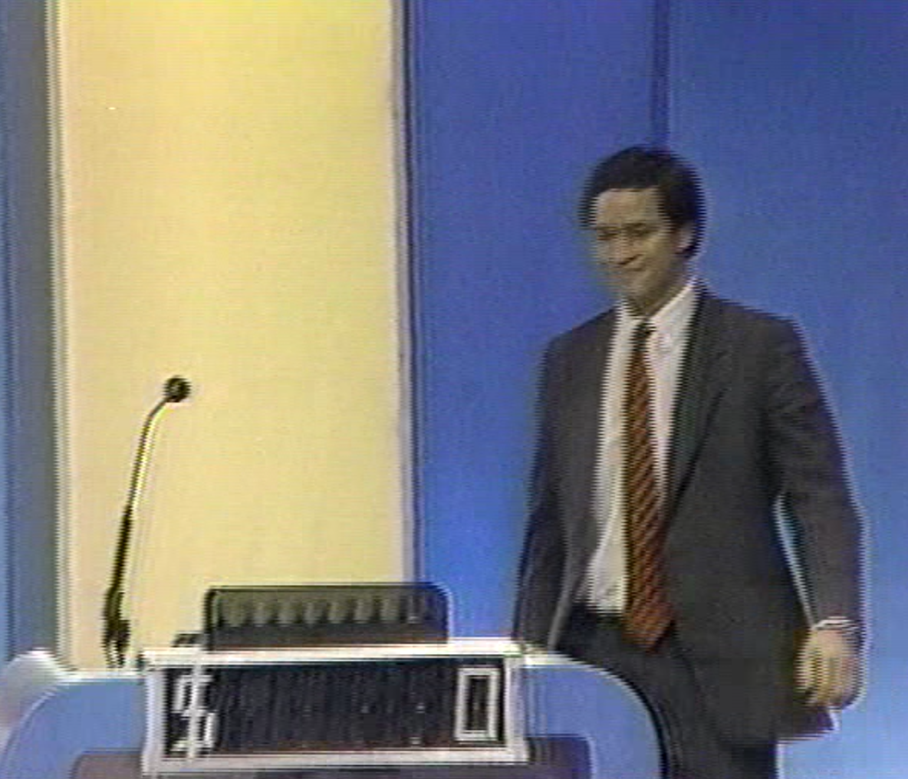

Slide 13
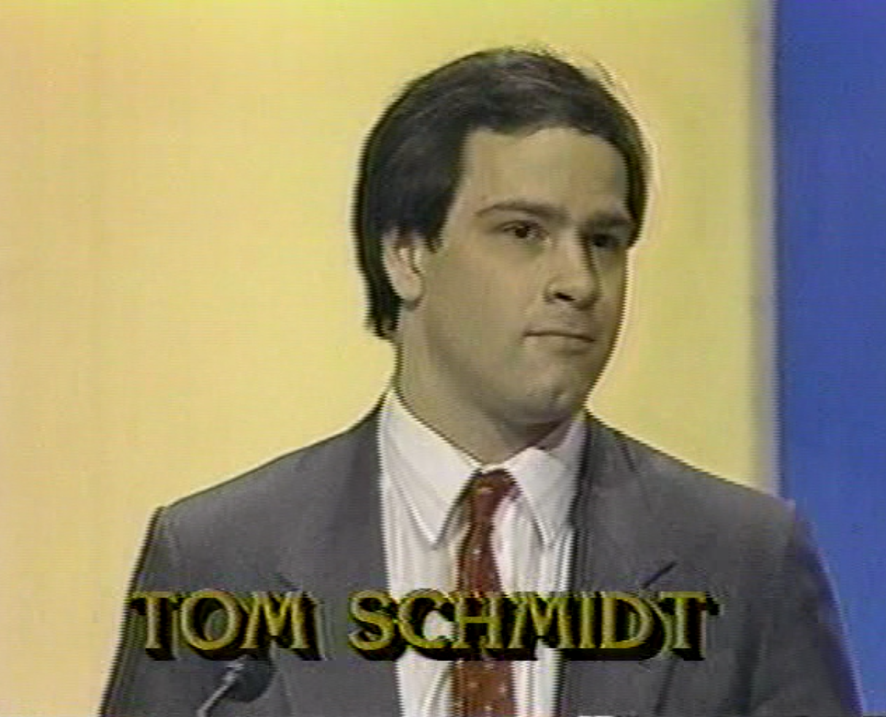

Slide 14
Dynamic Programming
Intro
Overview
Fibonacci and LCS
Matrix Chain Multiplication

Slide 15

Notes:
Dynamic programming involves
https://www.polleverywhere.com/multiple_choice_polls/2PtqUoVJwLZpYob

Slide 16
Notes:
What is one major advantage of Dynamic Programming that you've seen?
https://www.polleverywhere.com/free_text_polls/SDxM3Nsx9Vd25LW

Slide 17
Notes:
How fast do parenthesizations grow?
https://www.polleverywhere.com/multiple_choice_polls/CvaTcNy19Mwqr6F

Slide 18
Make a Midterm
50% : Individual, 5 Questions, Answer 4
25% : 2 people, 2 Questions
25% : 4 people, 2 Questions

Slide 19
Make a Midterm
Permitted materials?
Paper Book
Copy of any and all notes
Printed copies of homework sets you turned in
Printed copies of all slide decks posted on Blackboard

Slide 20
Make a Midterm
Individual Question Topics, by Chapter?
2: Getting Started, Insertion and Merge Sort
3: Growth of Functions (i.e. Math)
4: Divide and Conquer
5: Probabilistic and Randomized Algorithms
6: Heapsort
7: Quicksort
8: Radix/Counting Sort
9: Not examined
11: Hash Tables
13: Red-Black Trees
15: Dynamic Programming - Not examined

Slide 21
Make a Midterm
2 person question, by Chapter?
2: Getting Started, Insertion and Merge Sort
3: Growth of Functions (i.e. Math)
4: Divide and Conquer
5: Probabilistic and Randomized Algorithms
6: Heapsort
7: Quicksort
8: Radix/Counting Sort
9: Not examined
11: Hash Tables
13: Red-Black Trees
15: Dynamic Programming - Not examined

Slide 22
Make a Midterm
4 person question, by Chapter?
2: Getting Started, Insertion and Merge Sort
3: Growth of Functions (i.e. Math)
4: Divide and Conquer
5: Probabilistic and Randomized Algorithms
6: Heapsort
7: Quicksort
8: Radix/Counting Sort
9: Not examined
11: Hash Tables
13: Red-Black Trees
15: Dynamic Programming - Not examined

Slide 23
Make a Midterm
Individual Question Topics, by Chapter?
2: Getting Started, Insertion and Merge Sort
3: Growth of Functions (i.e. Math)
4: Divide and Conquer
5: Probabilistic and Randomized Algorithms
6: Heapsort
7: Quicksort
8: Radix/Counting Sort
9: Not examined
Regular Languages and Automata
13: Red-Black Trees
15: Dynamic Programming - Not examined

Slide 24
Make a Midterm
2 person question, by Chapter?
2: Getting Started, Insertion and Merge Sort
3: Growth of Functions (i.e. Math)
4: Divide and Conquer
5: Probabilistic and Randomized Algorithms
6: Heapsort
7: Quicksort
8: Radix/Counting Sort
9: Not examined
Regular Languages and Automata
13: Red-Black Trees
15: Dynamic Programming - Not examined

Slide 25
Make a Midterm
4 person question, by Chapter?
2: Getting Started, Insertion and Merge Sort
3: Growth of Functions (i.e. Math)
4: Divide and Conquer
5: Probabilistic and Randomized Algorithms
6: Heapsort
7: Quicksort
8: Radix/Counting Sort
9: Not examined
Regular Languages and Automata
13: Red-Black Trees
15: Dynamic Programming - Not examined

Slide 26
Google Interview
A member of Teams BMW and Brandenburg

Slide 27
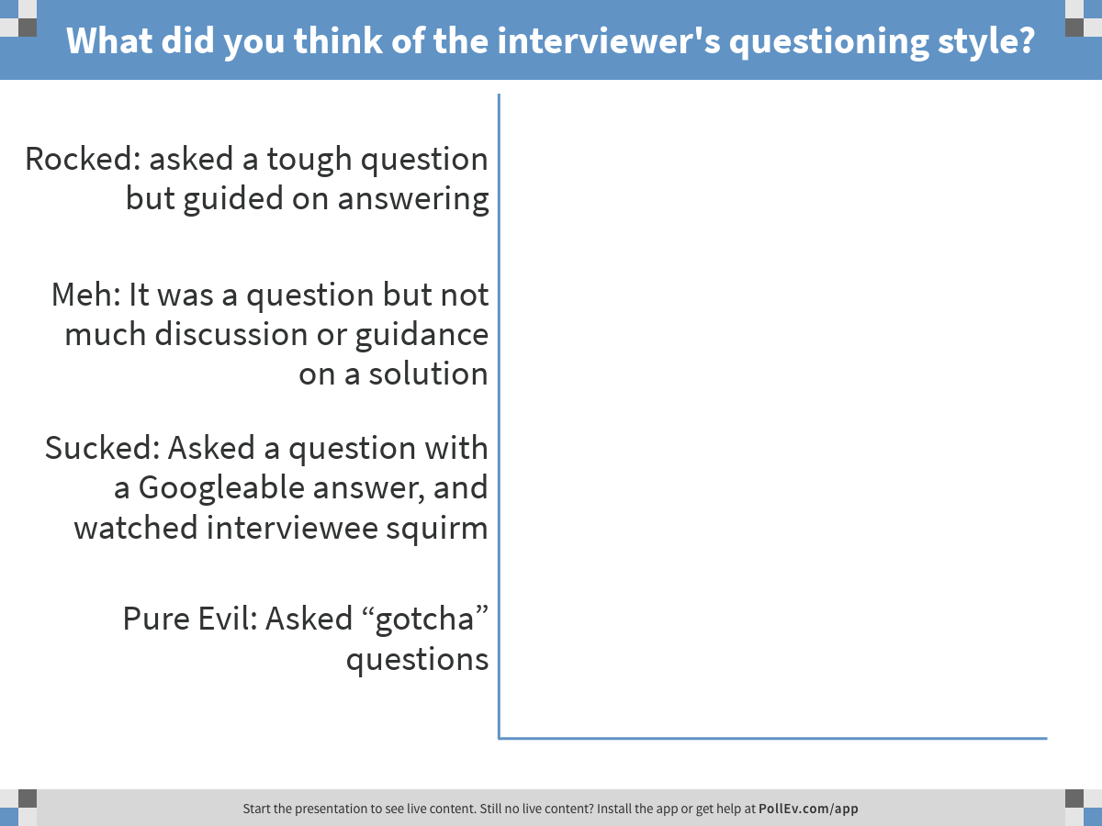
Notes:
What did you think of the interviewer's questioning style?
https://www.polleverywhere.com/multiple_choice_polls/gXPkEw1cpnly2ho

Slide 28
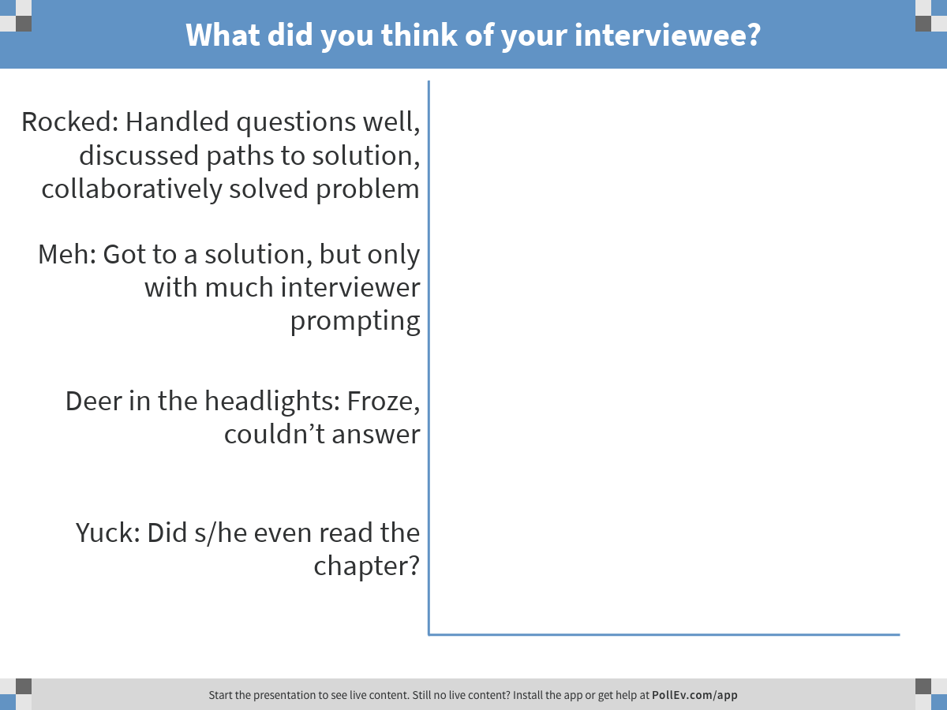
Notes:
What did you think of your interviewee?
https://www.polleverywhere.com/multiple_choice_polls/2Bcwzs8oRbfzQ4C

Slide 29
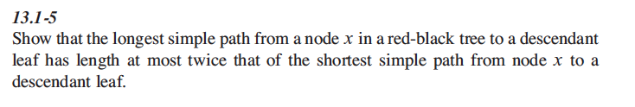
Exercise 13.1-5 page 312 Team Neuschwanstein

Slide 30
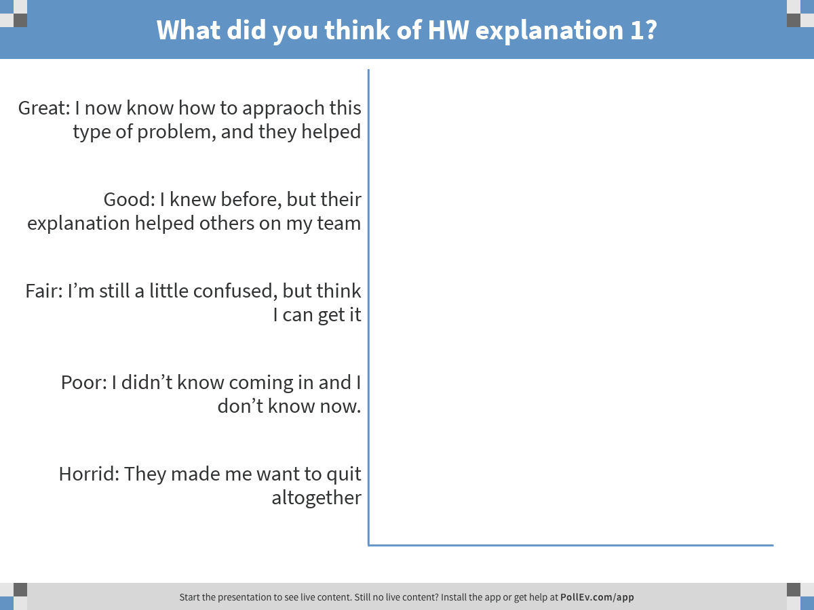
Notes:
What did you think of HW explanation 1?
https://www.polleverywhere.com/multiple_choice_polls/8vmrgZ3VhcBHQvH

Slide 31
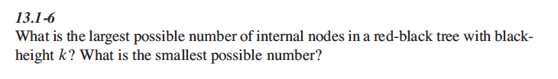
Problem 13.1-6: Team Hamburg

Slide 32
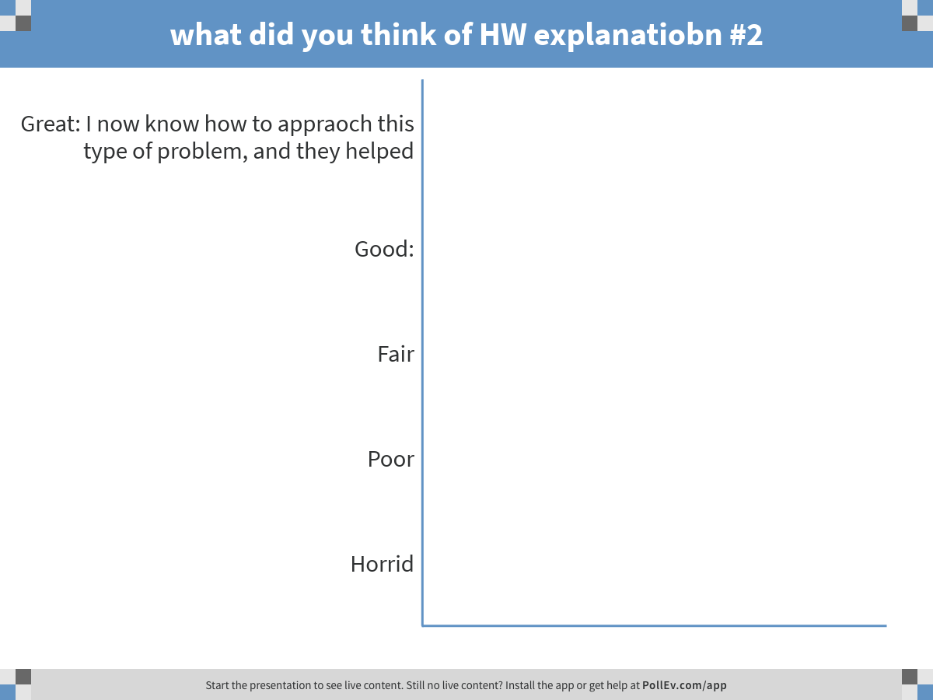
Notes:
what did you think of HW explanatiobn #2
https://www.polleverywhere.com/multiple_choice_polls/BL1zpHfb2mm0Ruz

Slide 33
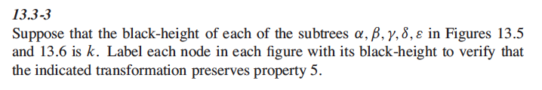
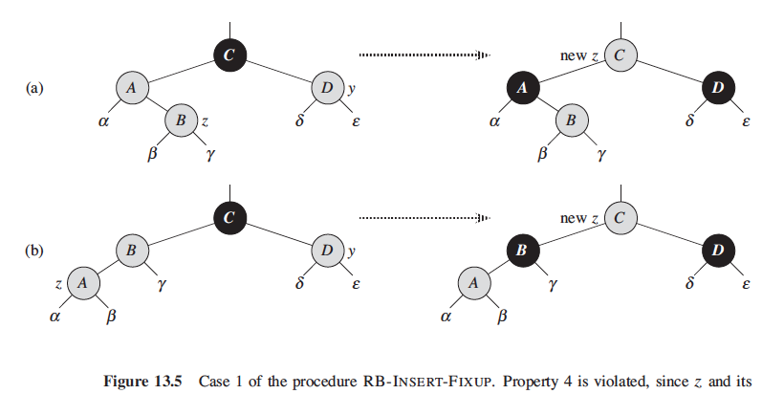
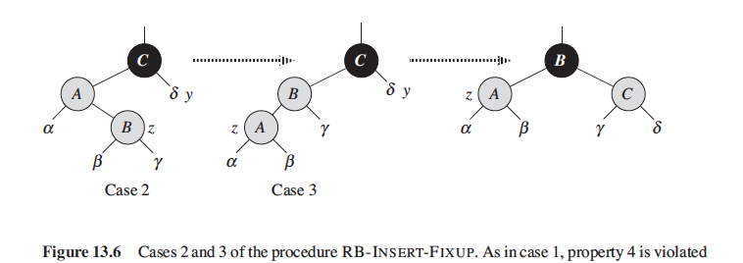
Exercise 13.3-3: Goethe

Slide 34
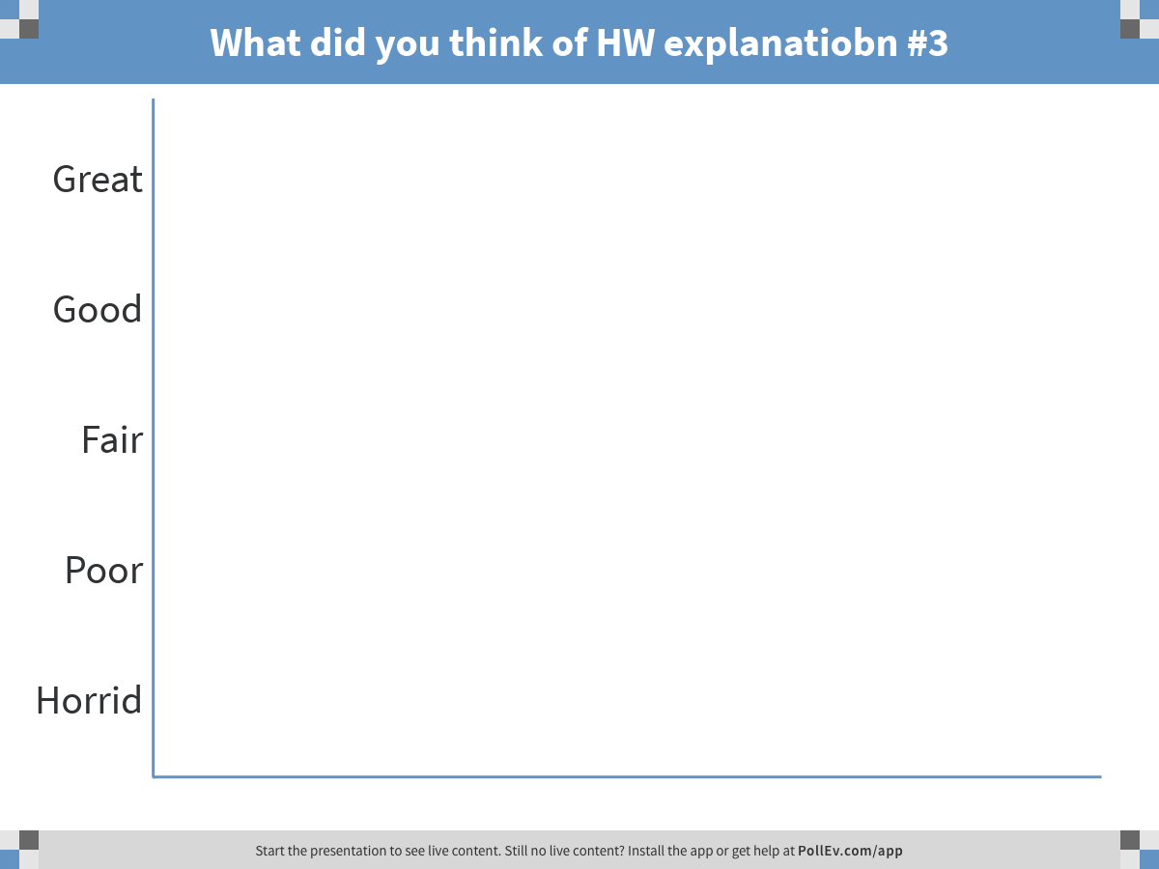
Notes:
What did you think of HW explanatiobn #3
https://www.polleverywhere.com/multiple_choice_polls/Yafw9lfl8l8gPr8

Slide 35
Wrap-up and review
What will you do over Spring Break?
Thank you and may the road rise up to greet you, and may God always hold you in the palm of His hand

